Slide 1
Mastering TestRail: Manual & Automated Testing With Jest And Jira Integration
Centralized Test Management for Modern QA Workflows
Presented by: Syeda Tamanna Sheme

Slide 2


Voice-enabled AI Chatbot With Context Awareness In LMS
Client: Employability.Life
Client Name: Neeraj Singh
Client contact details NSingh@employability.life

Slide 3
Introduction To TestRail
What is TestRail? - A web-based test case management tool used by QA teams to manage, organize, and track software testing.
Why use it for test management?
Centralized repository for manual and automated tests
Integrates easily with tools like Jira, Jenkins, and CI/CD pipelines
Tracks execution, results, and test history
Supports Agile workflows and collaboration

Slide 4
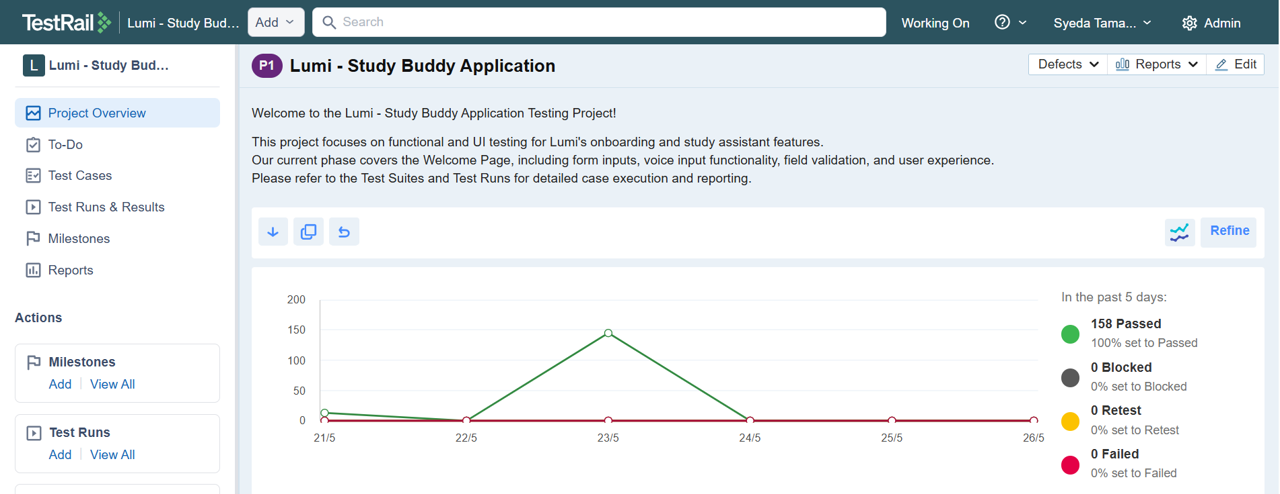
TestRail Dashboard

Slide 5
Creating Test Cases
Define test cases with clear steps, expected results, and preconditions
1
Use sections and suites to organize by feature or module
2
Assign priority, type, and custom fields as needed
3
Add references to related Jira tickets (e.g., SCRUM-101)
4

Slide 6
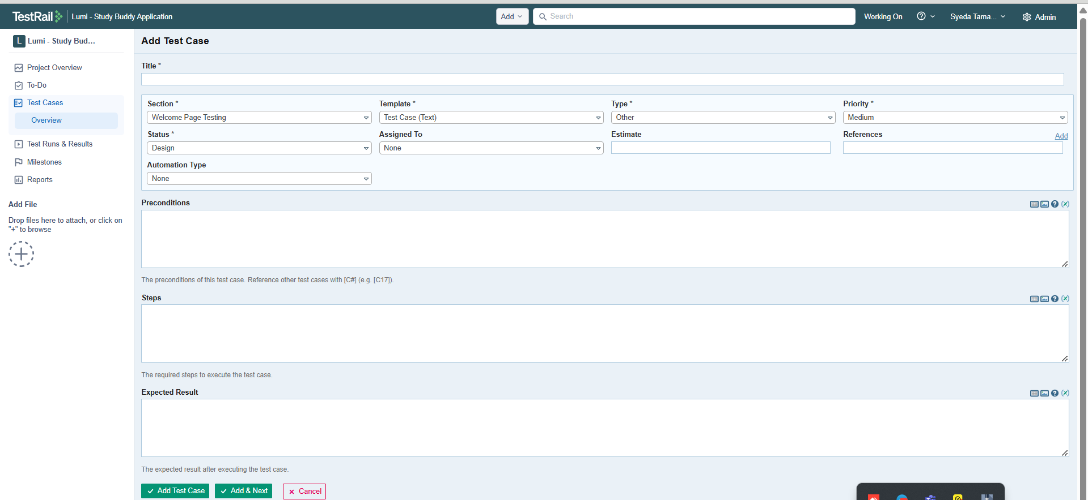
Creating Test Cases

Slide 7
Managing Test Runs & Results
Create a Test Run by selecting test cases from a suite
Assign test cases to specific testers or teams
During execution, update the status: Passed, Failed, Blocked, or Retest
Attach evidence (screenshots, logs), and comments per test case
Monitor progress in real time using Test Run dashboard
Export results or generate reports for QA review

Slide 8
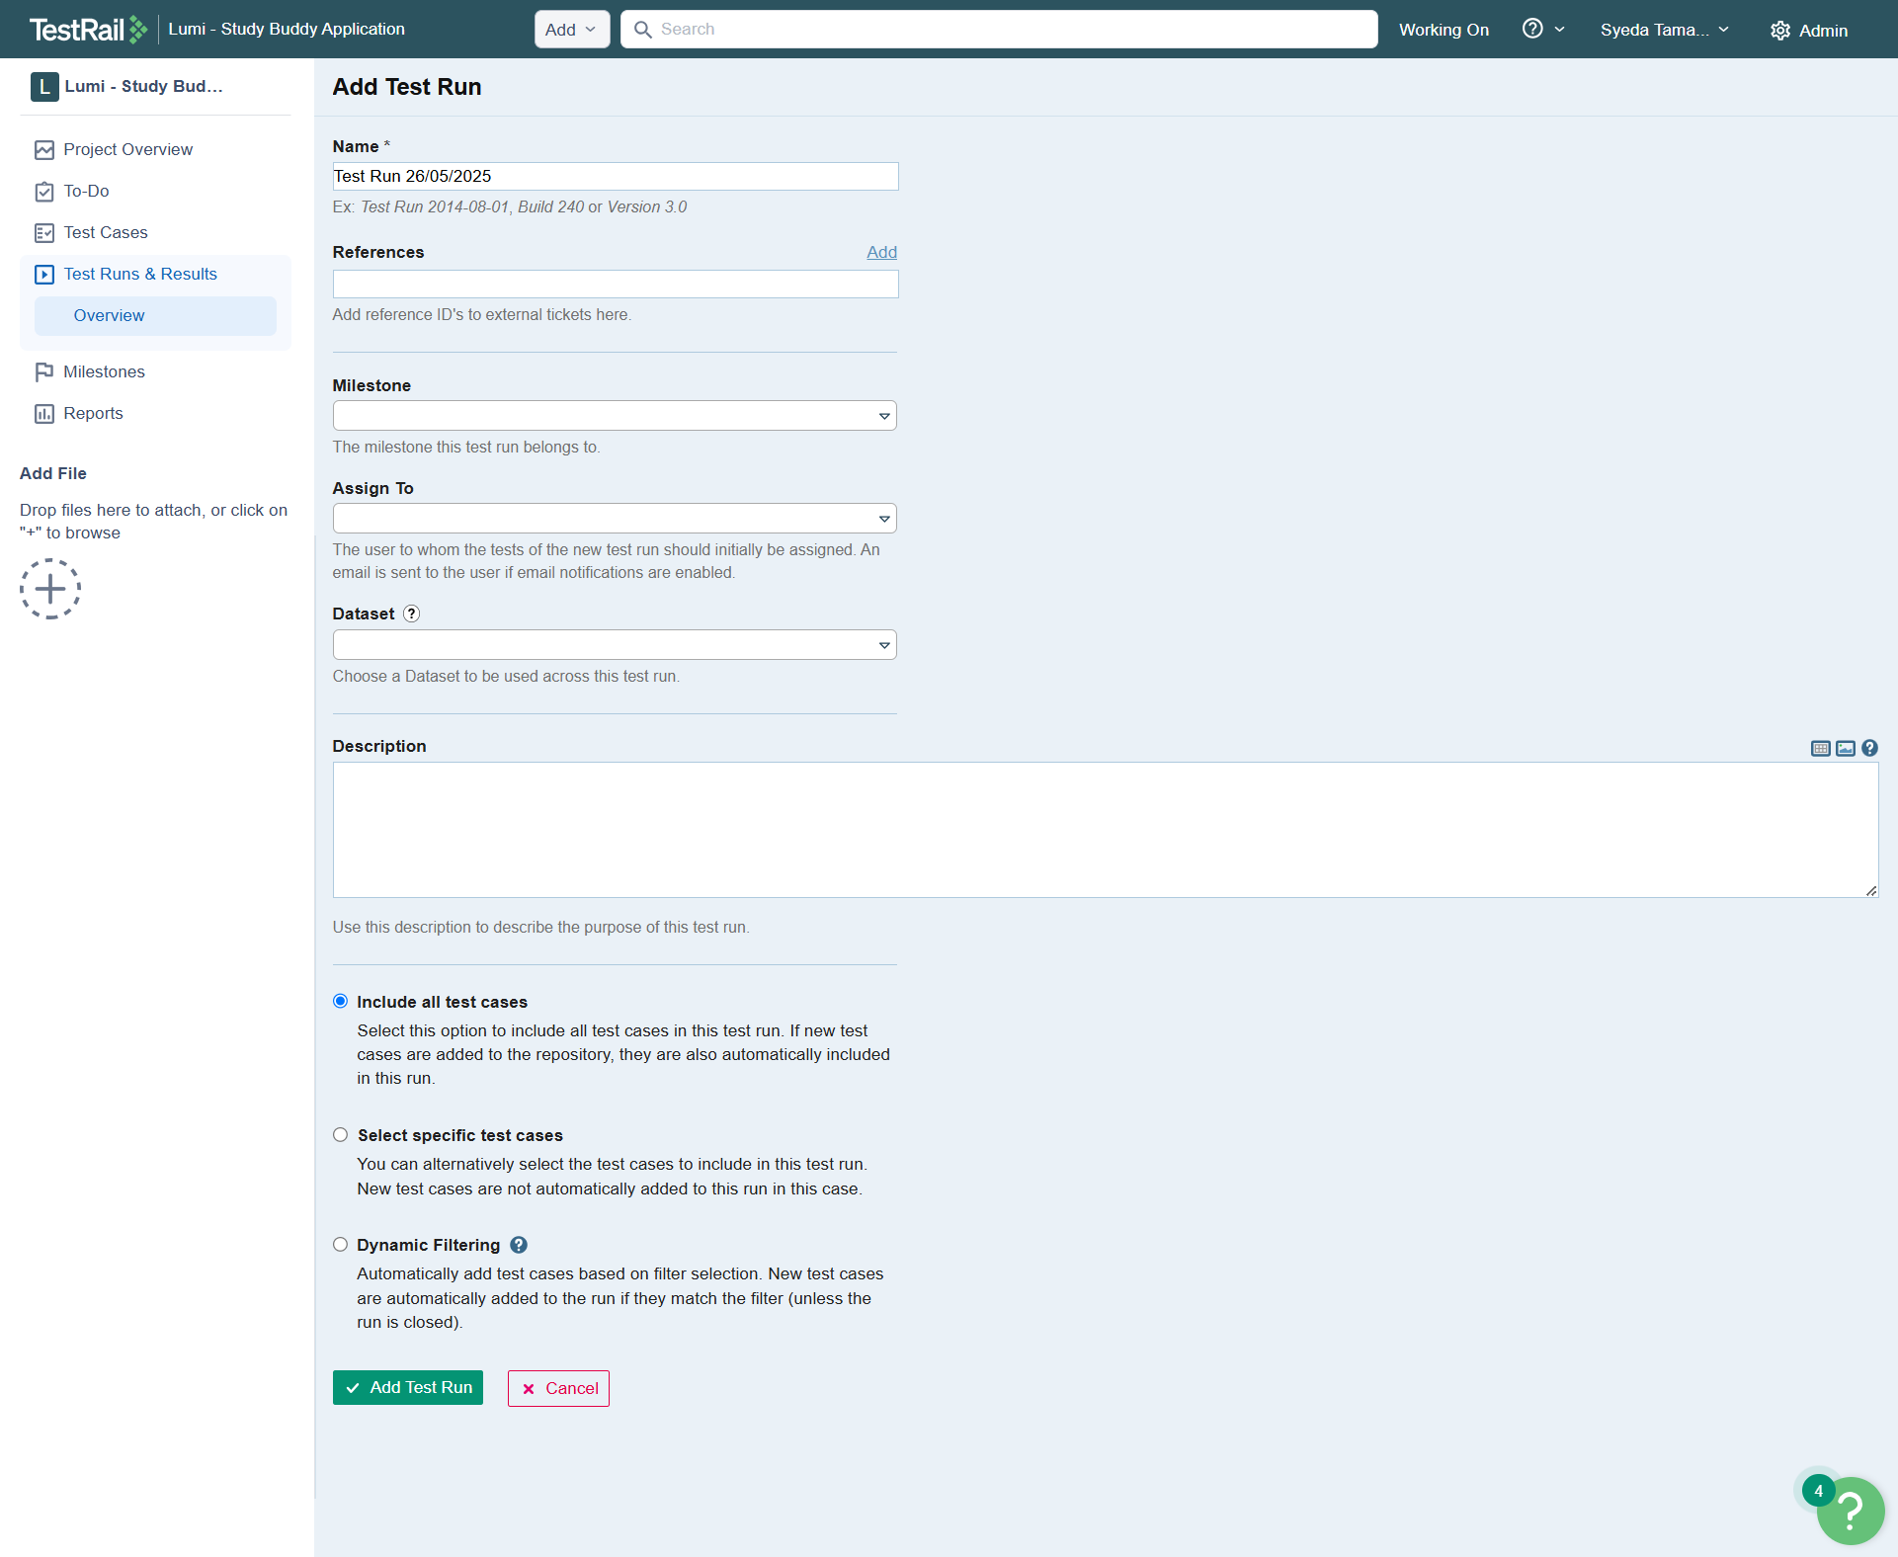
Managing Test Runs & Results

Slide 9
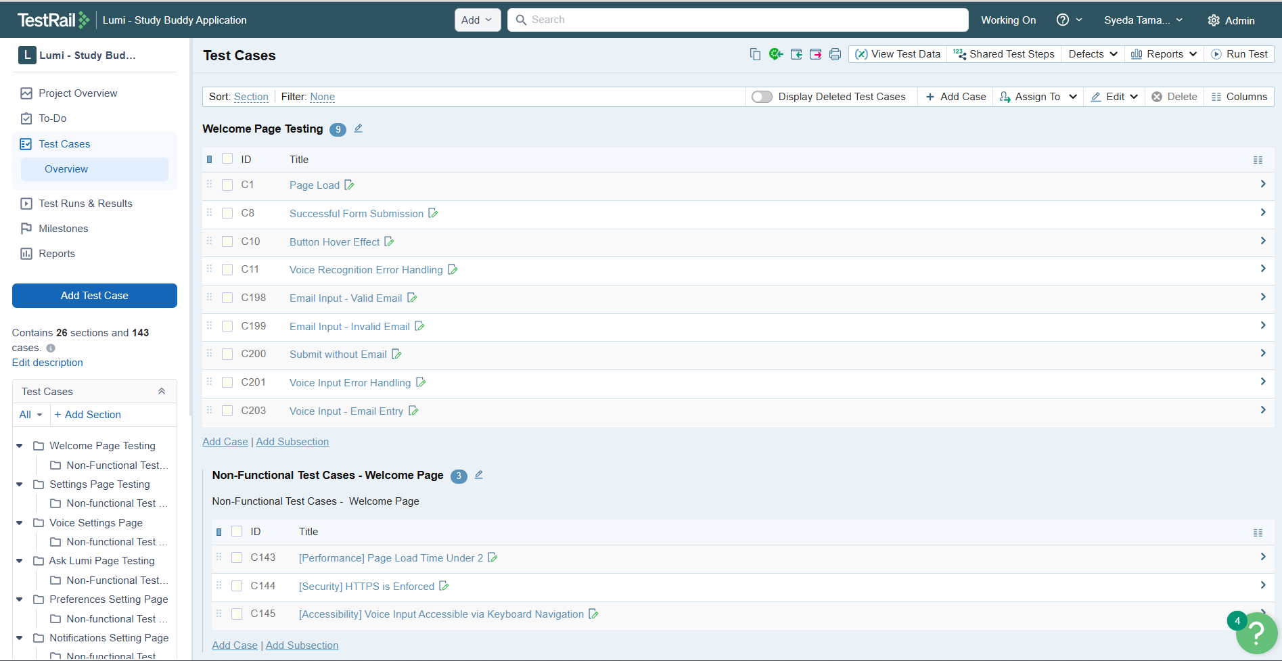
Test Cases

Slide 10
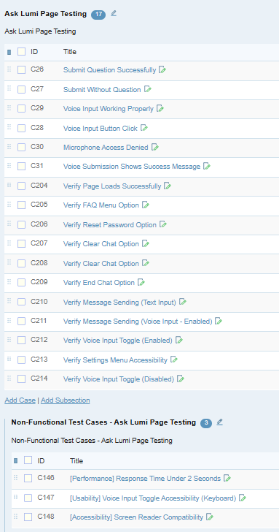
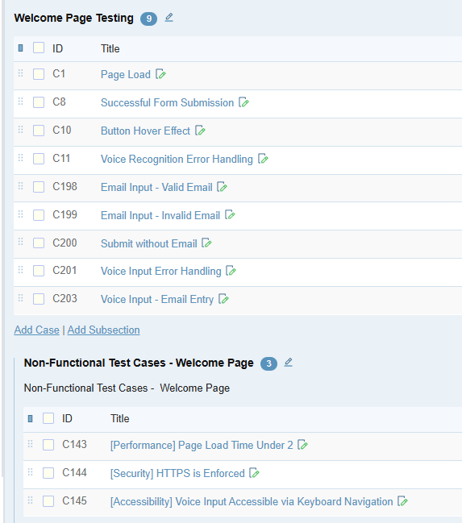
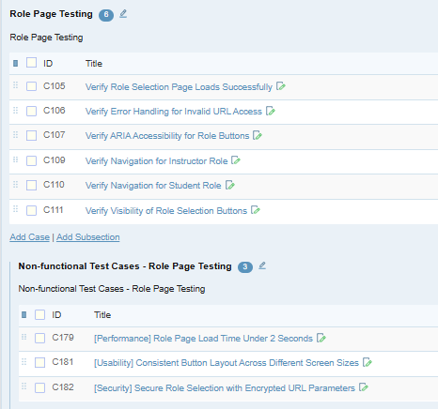
Test Cases In Test Rail
Test Rail Test Case Report: https://drive.google.com/file/d/1sDyVEi-_MntK-1LeIjt_OlNjqbVsbi9a/view?usp=drive_link

Slide 11
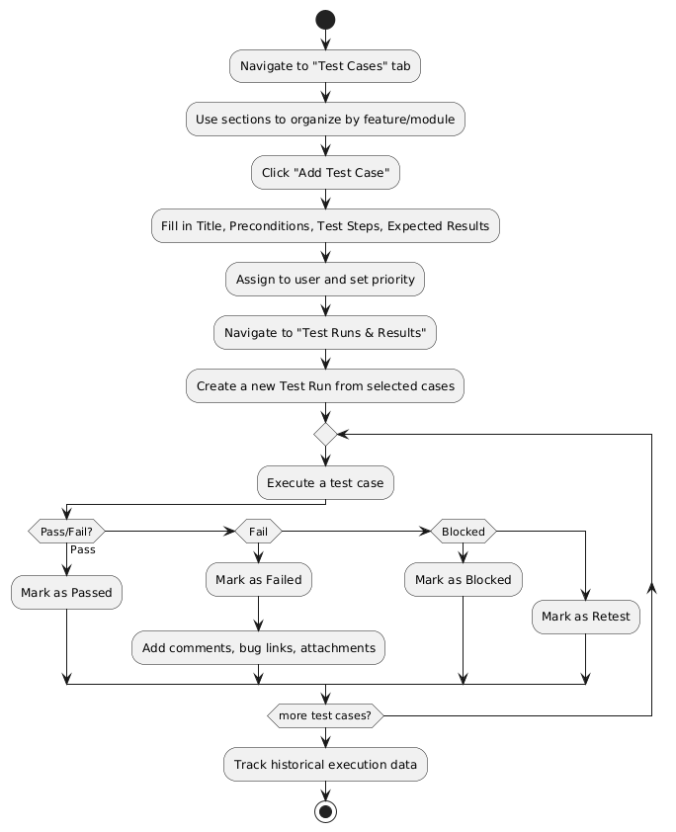
TestRail Workflow: From Test Case Creation To Execution

Slide 12
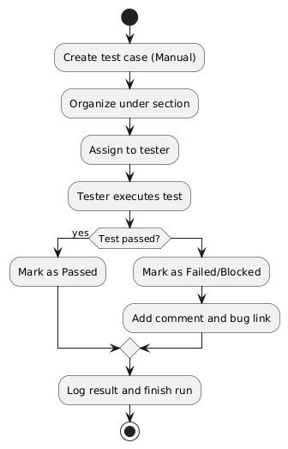
Manual Testing In TestRail
Create structured test cases with step-by-step actions
Organize test cases into sections and suites
Assign test cases to testers for manual execution
Execute tests and record outcomes (Pass/Fail/Blocked/Retest)
Add comments, evidence (screenshots/logs), and bug references
Use test runs to group and track manual testing progress
Review historical execution data for each test case

Slide 13
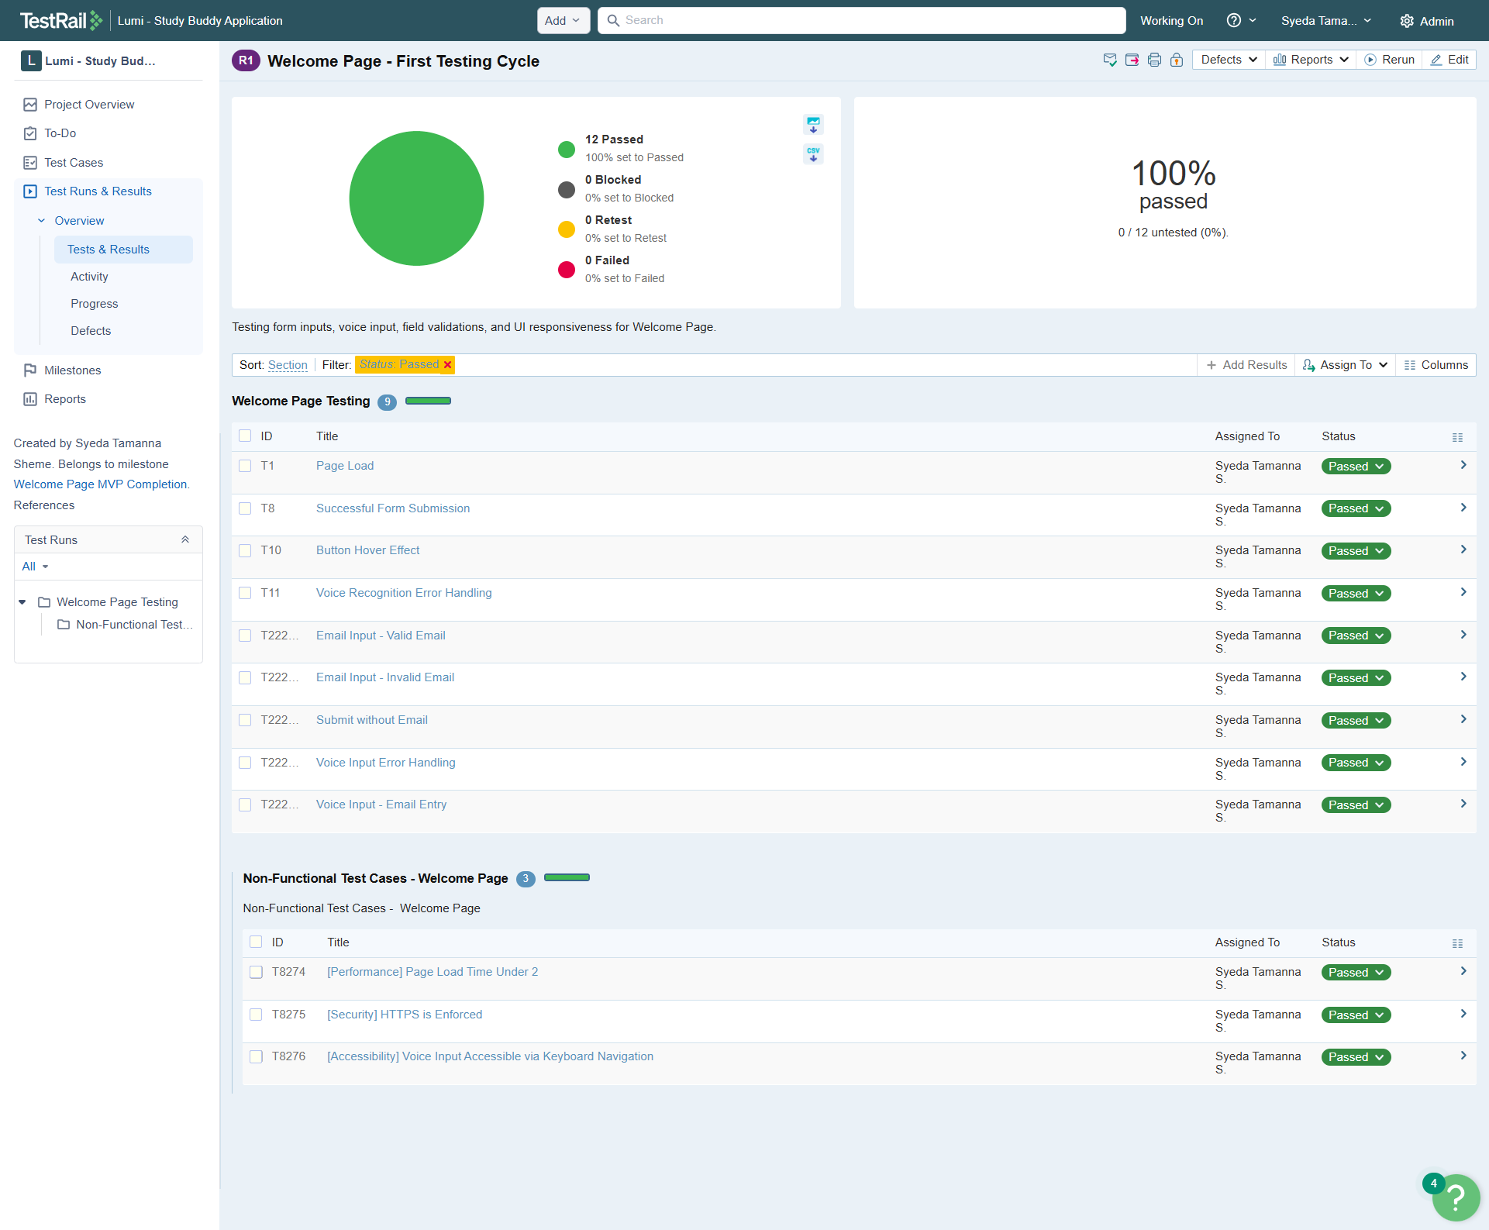
Manual Testing

Slide 14
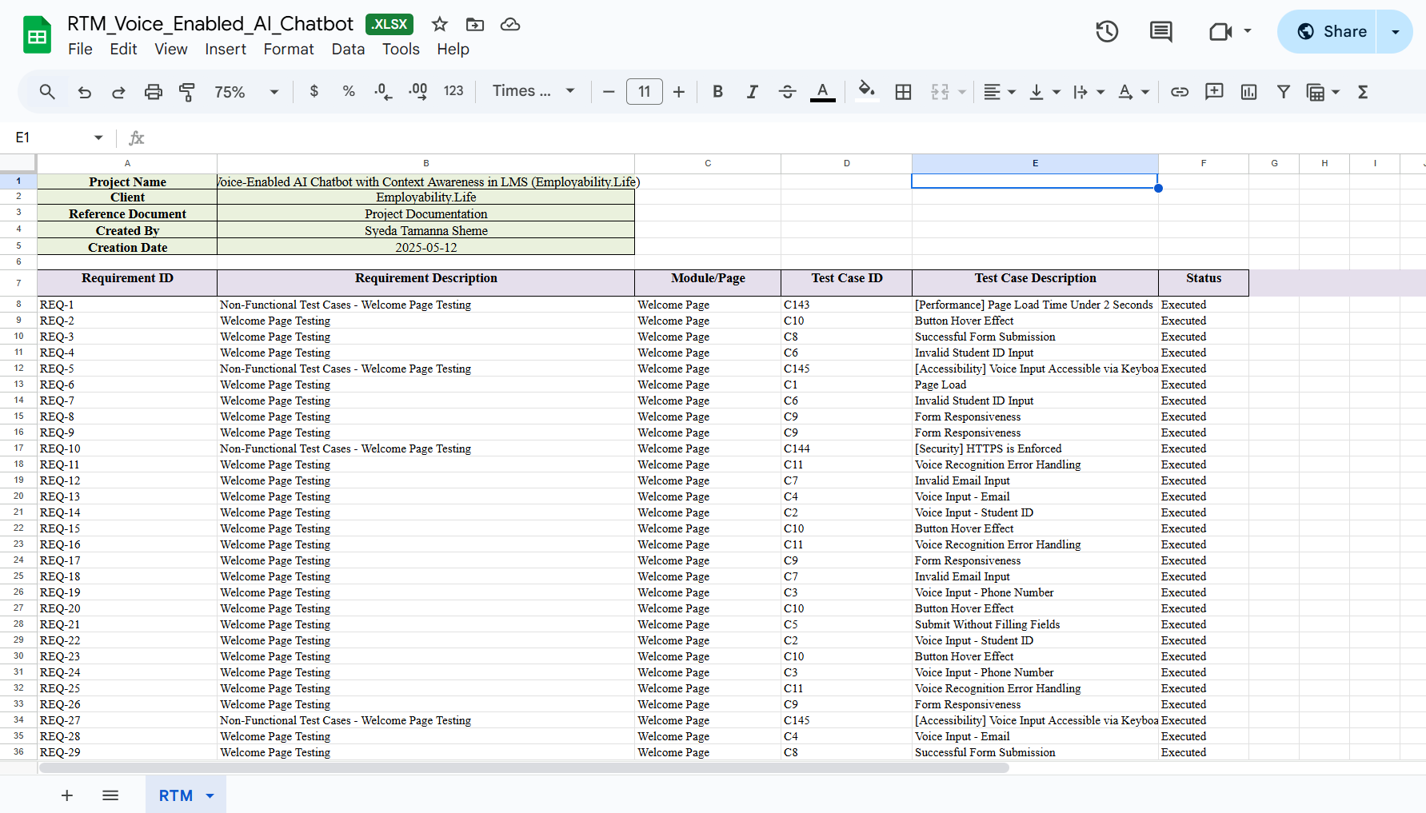
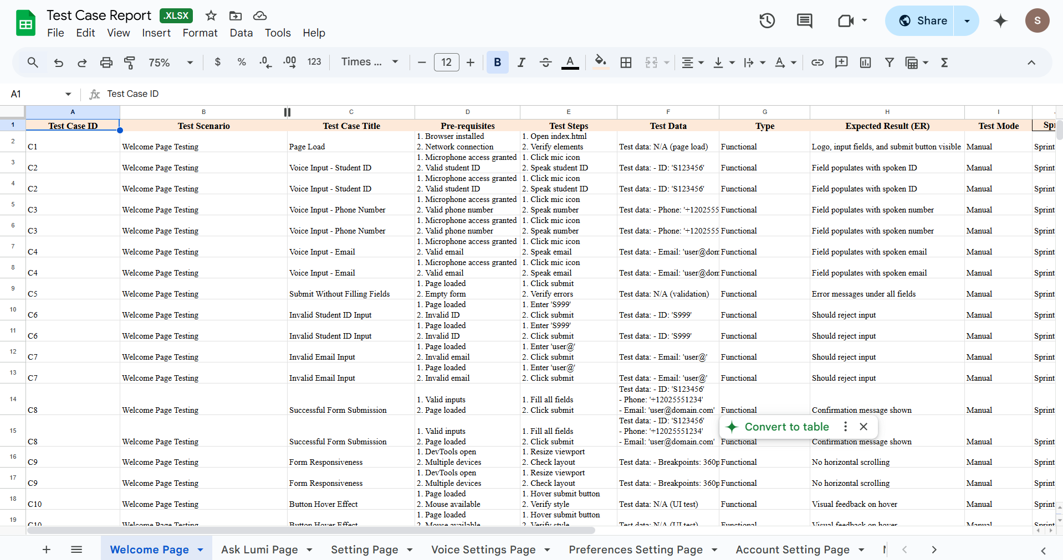
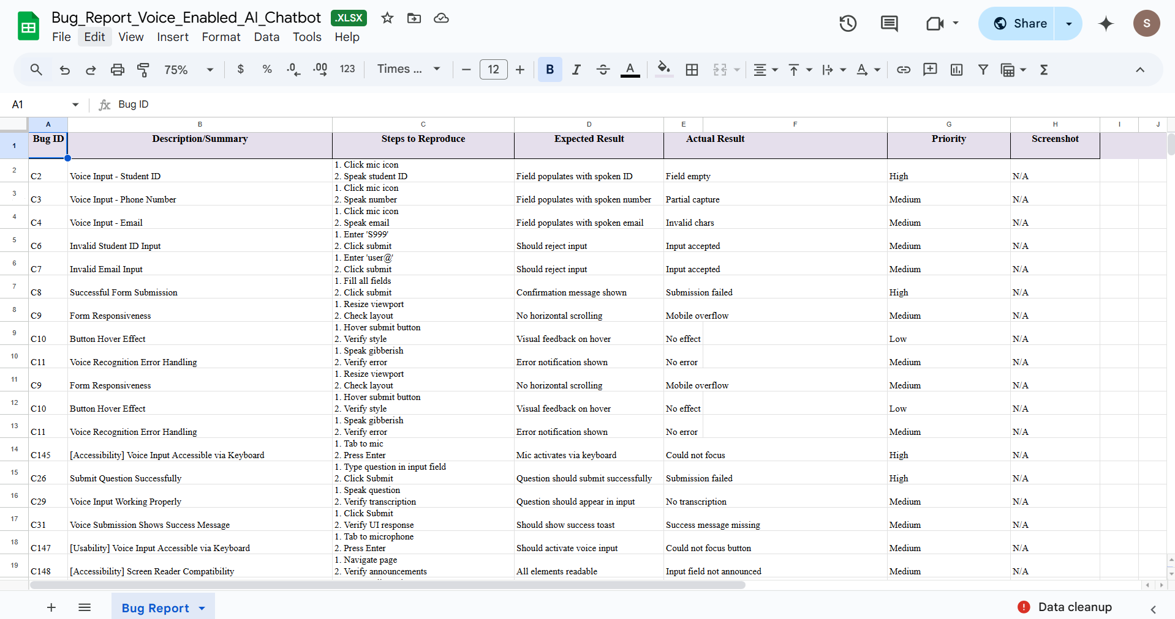
Test Case Report
Test Report: https://drive.google.com/drive/folders/1AshX_VE1_nswa40QP7ejbNJPe4hfbRwE?usp=drive_link

Slide 15
Automation Integration With Jest
Use `jest-testrail` or custom reporter
01
After Jest test execution, push results to TestRail
02
Benefits: single view of all tests, automated tracking
03

Slide 16
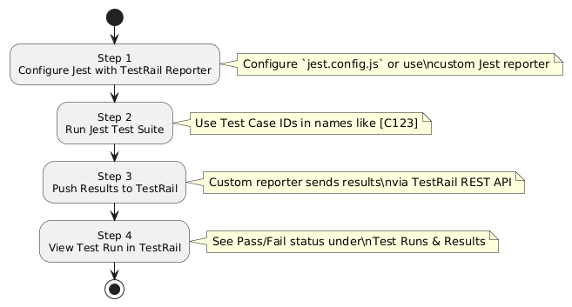
Jest → TestRail Automation Flow
jest.config.js or testrail.config.js File
Terminal Output After Jest Test Run
Test Case Naming with Case IDs
TestRail Run View After Automation Push

Slide 17
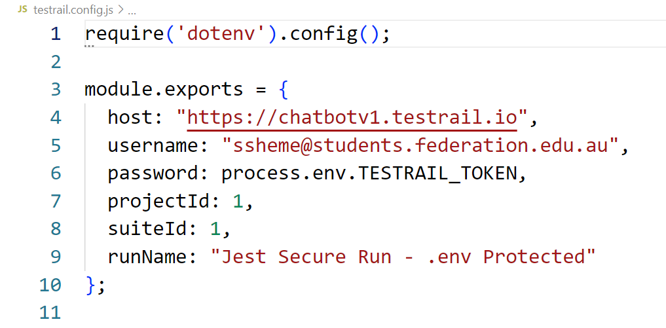
testrail.config.js File

Slide 18
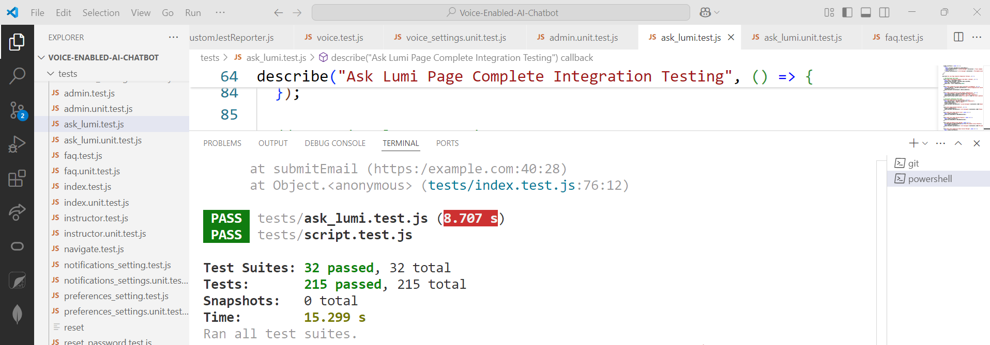
Terminal Output

Slide 19
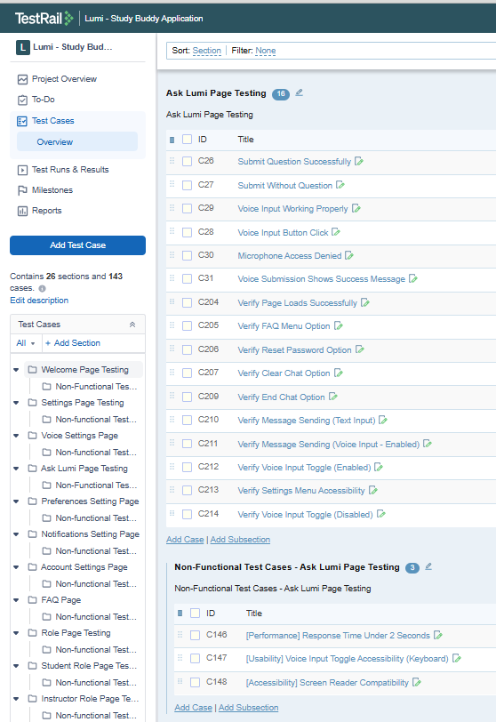
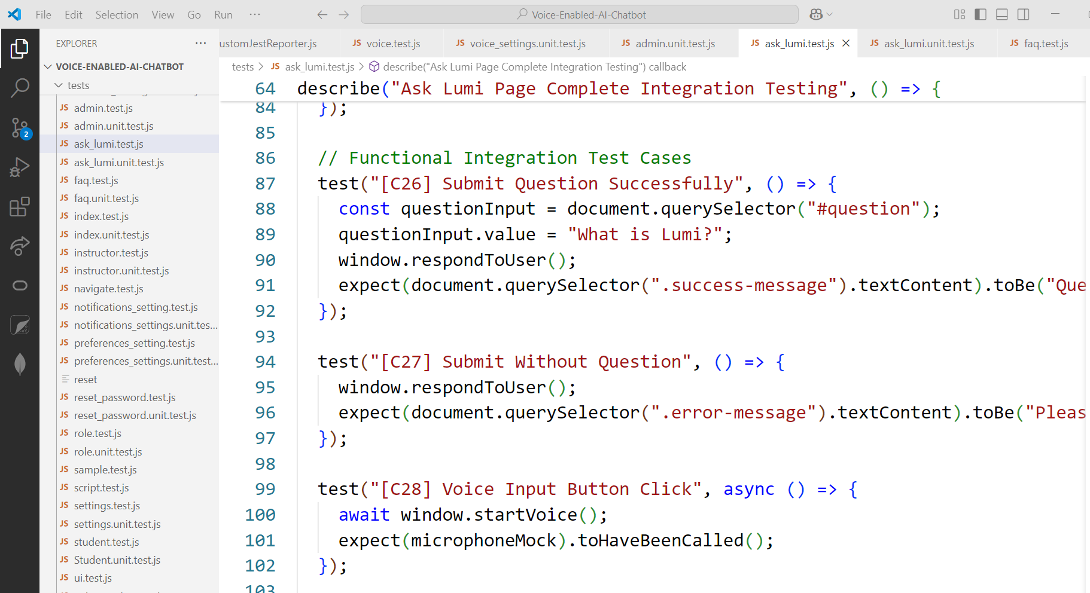
Test Case Naming With Case Ids

Slide 20
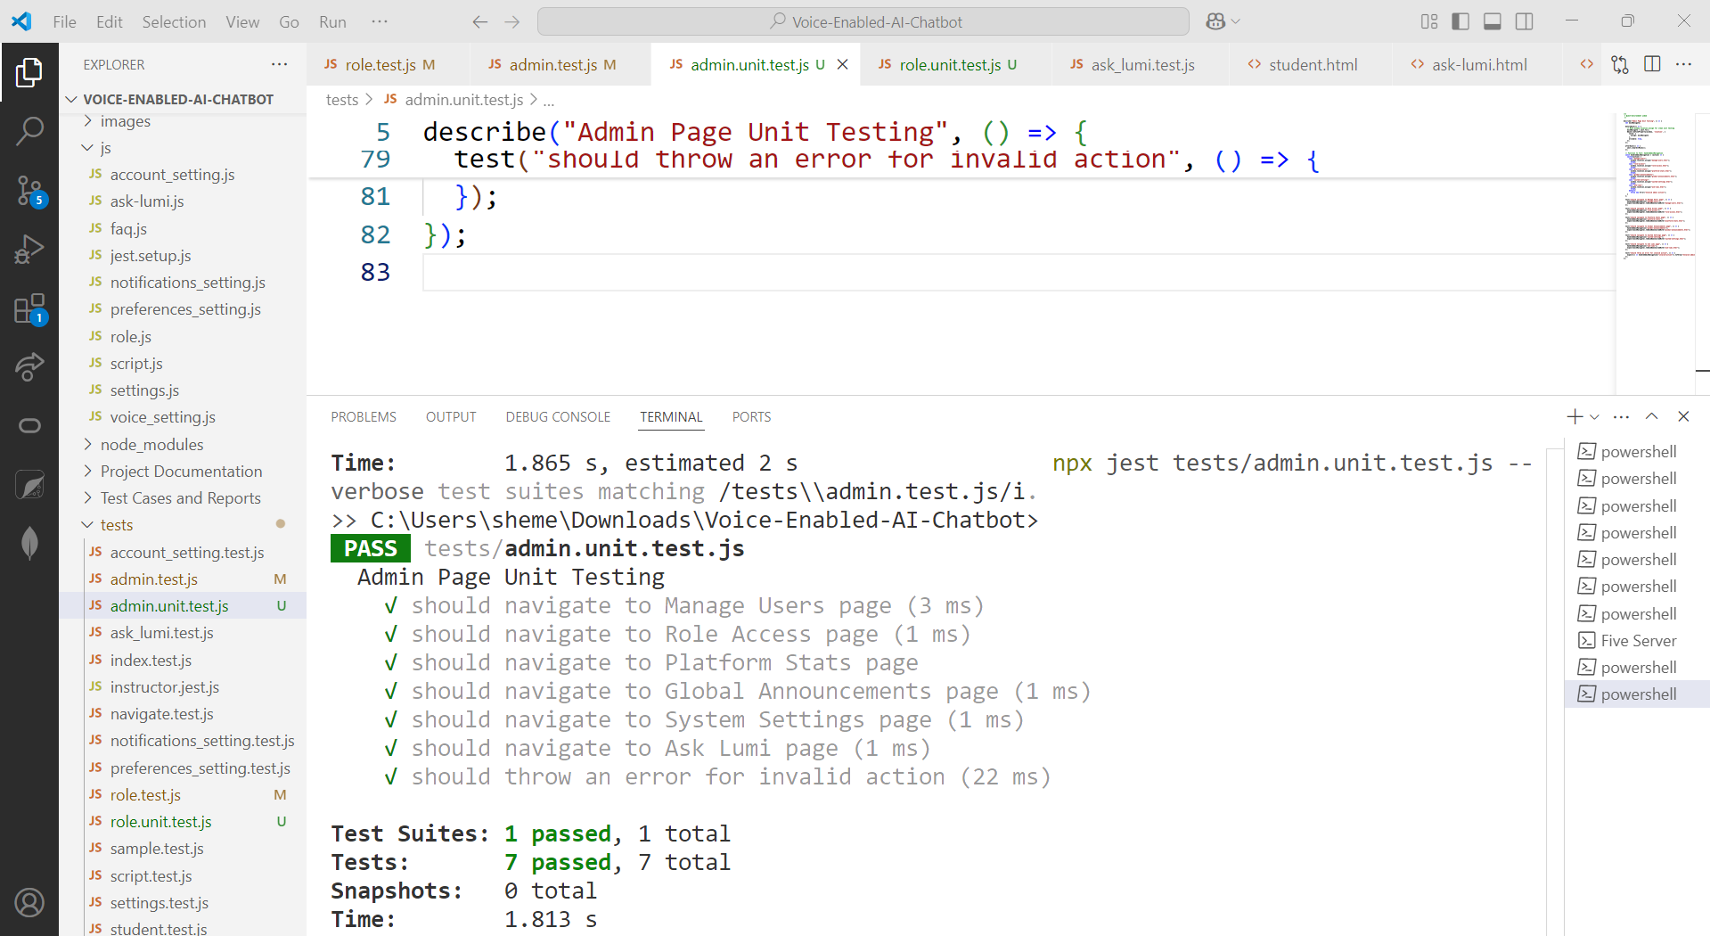
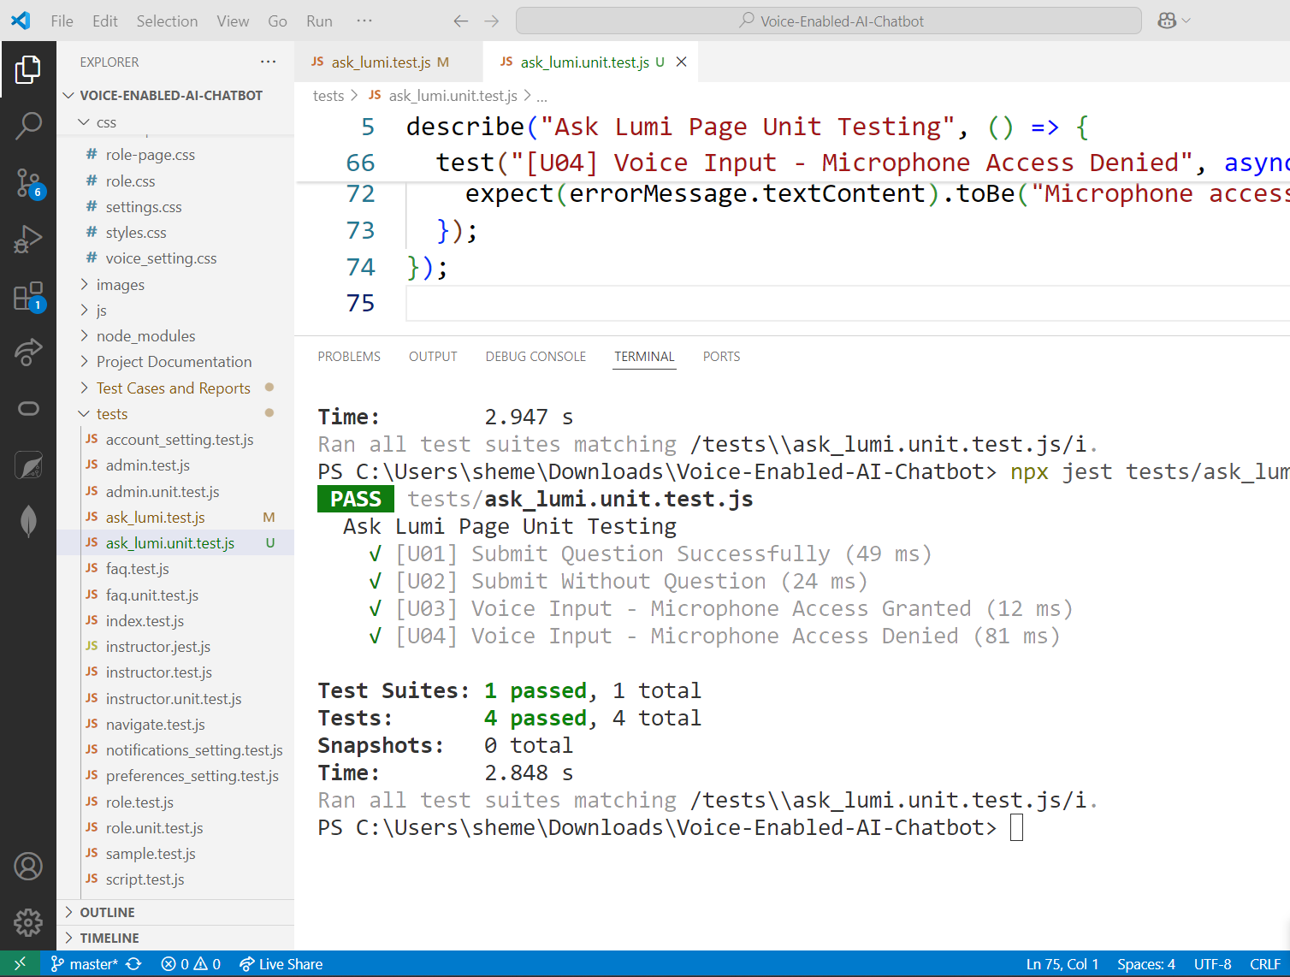
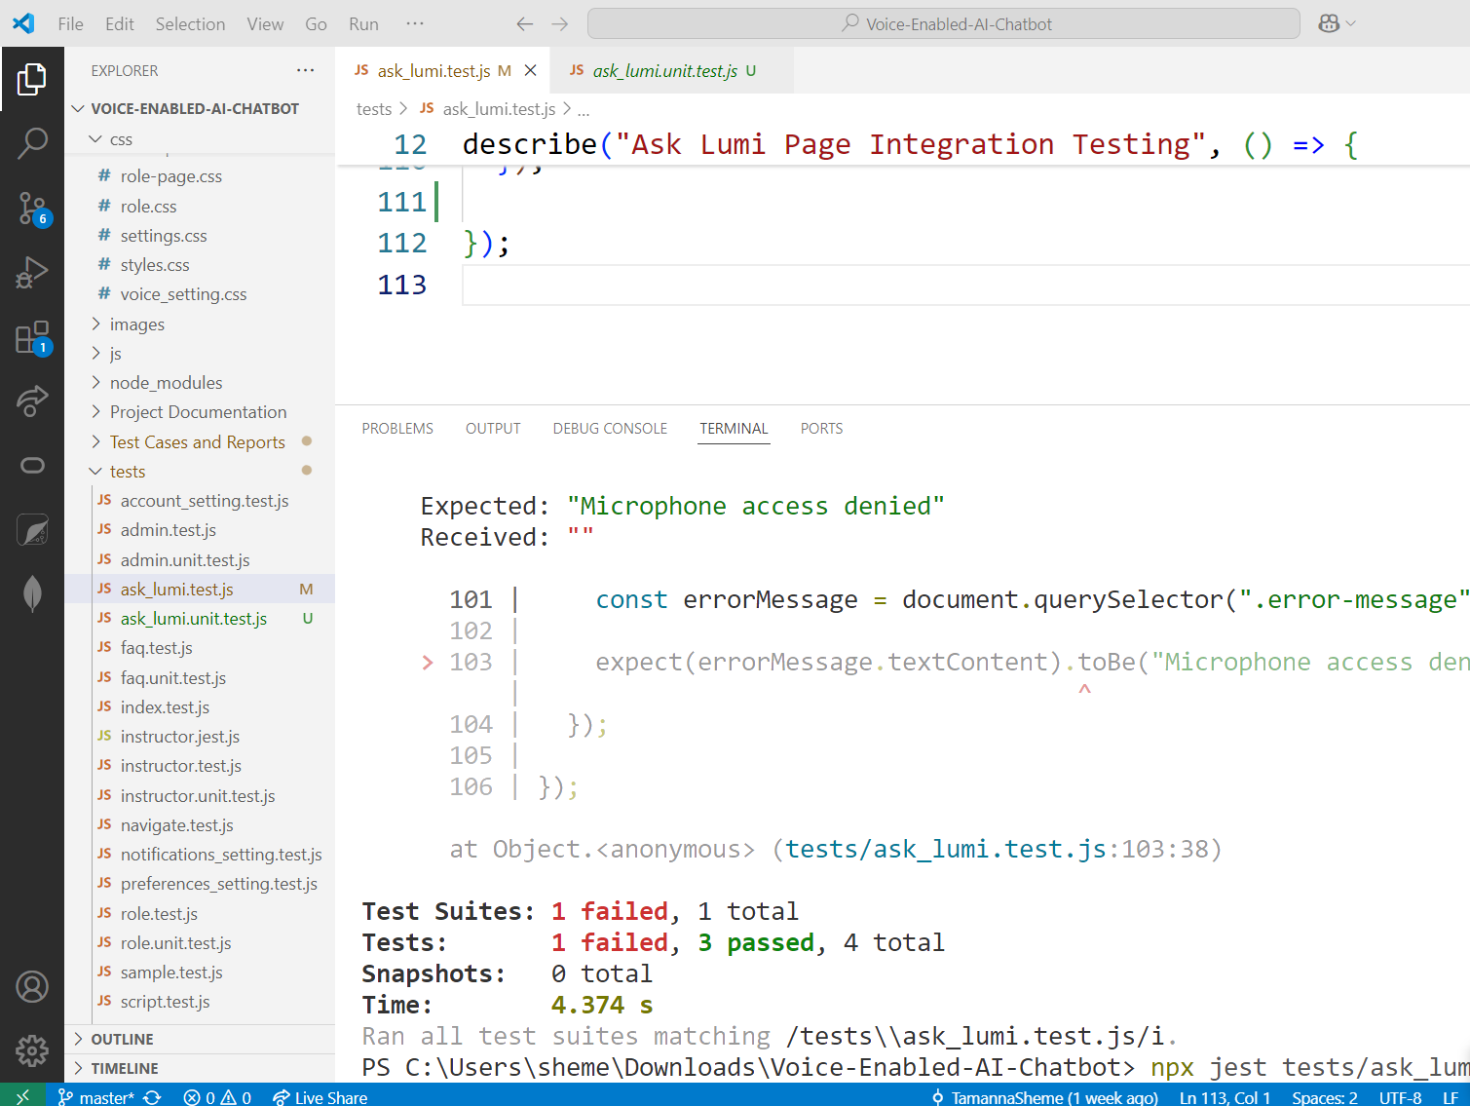
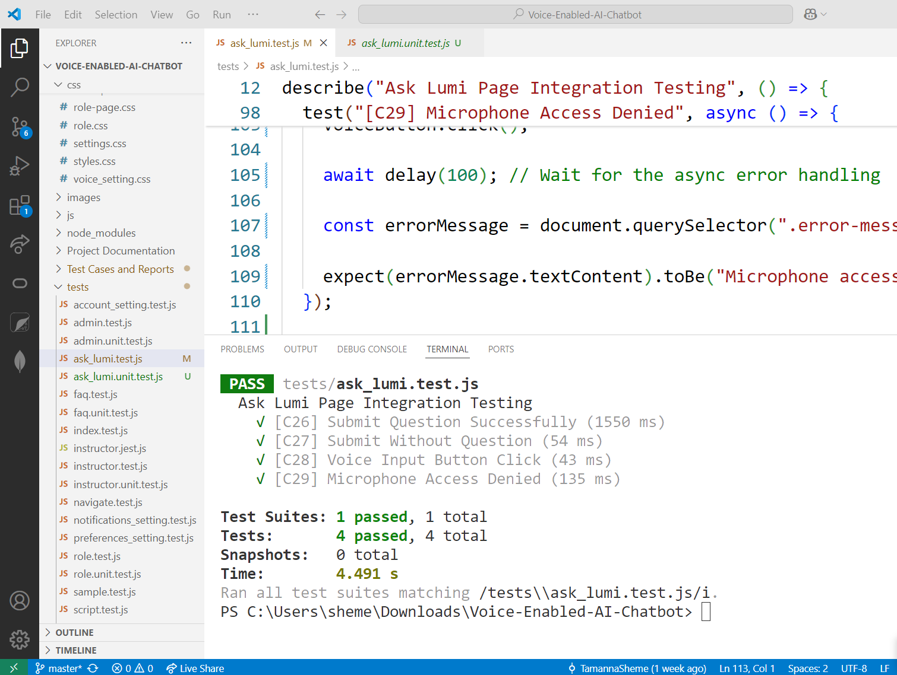
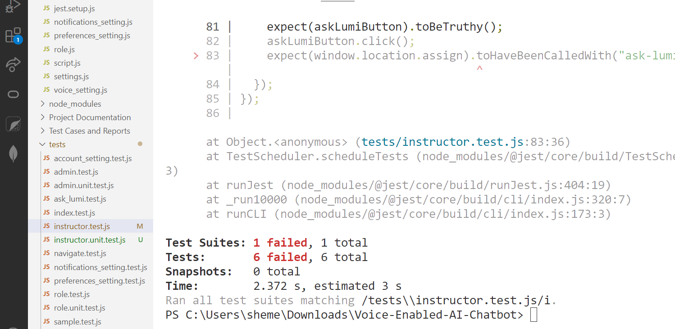
Test Run Results

Slide 21
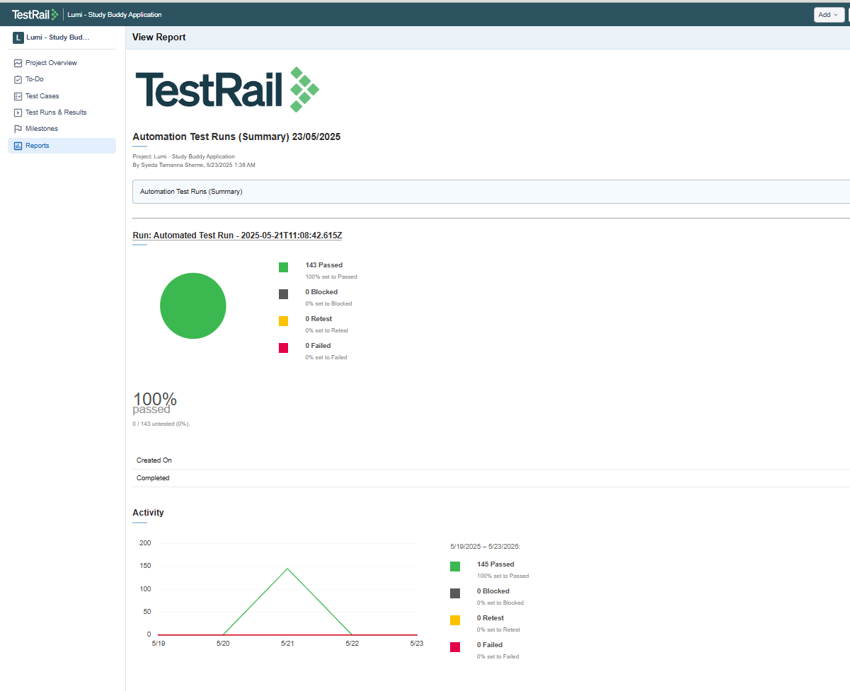
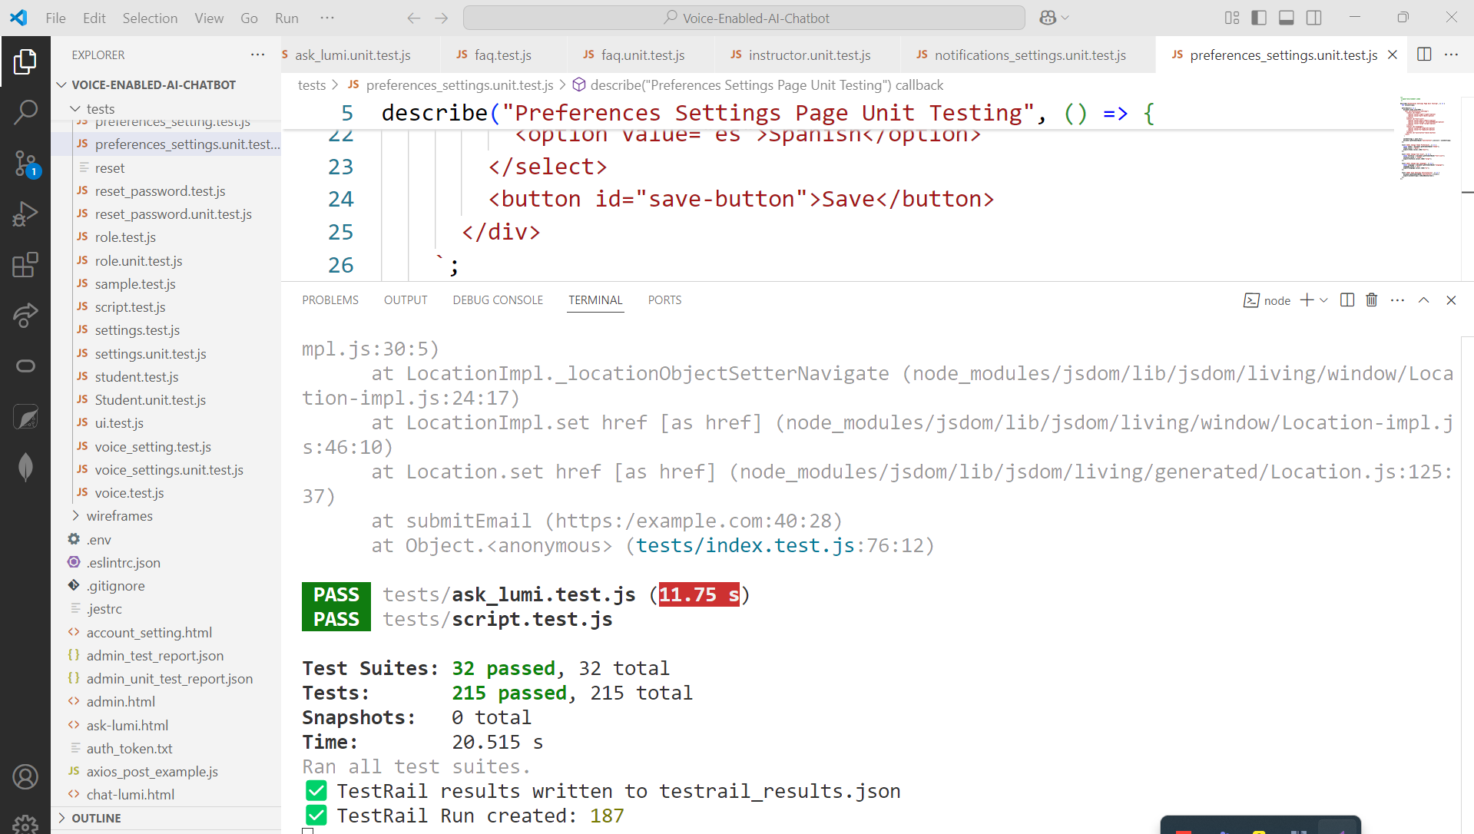
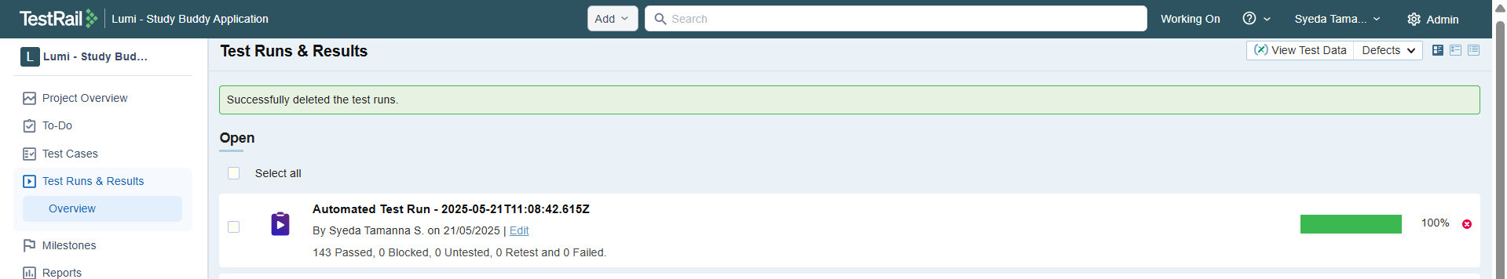
Test Cases Passed
Automation Test Run Report: https://drive.google.com/file/d/1CEPNJyByFLky1uS3r3OpZctw9Jxb6bGL/view?usp=drive_link

Slide 22
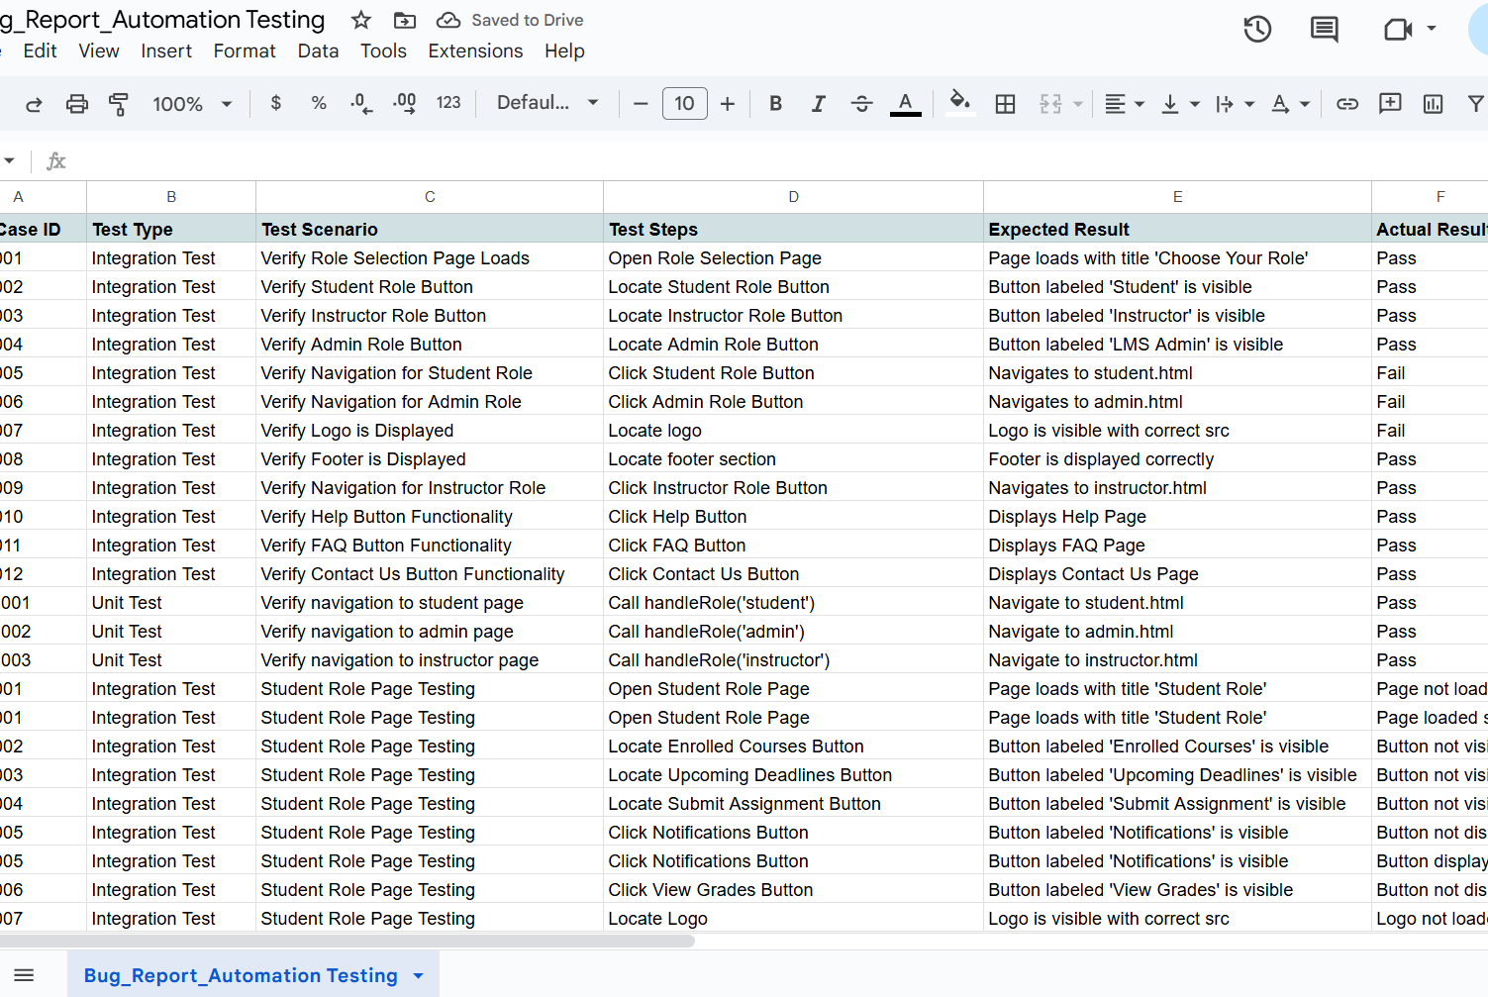
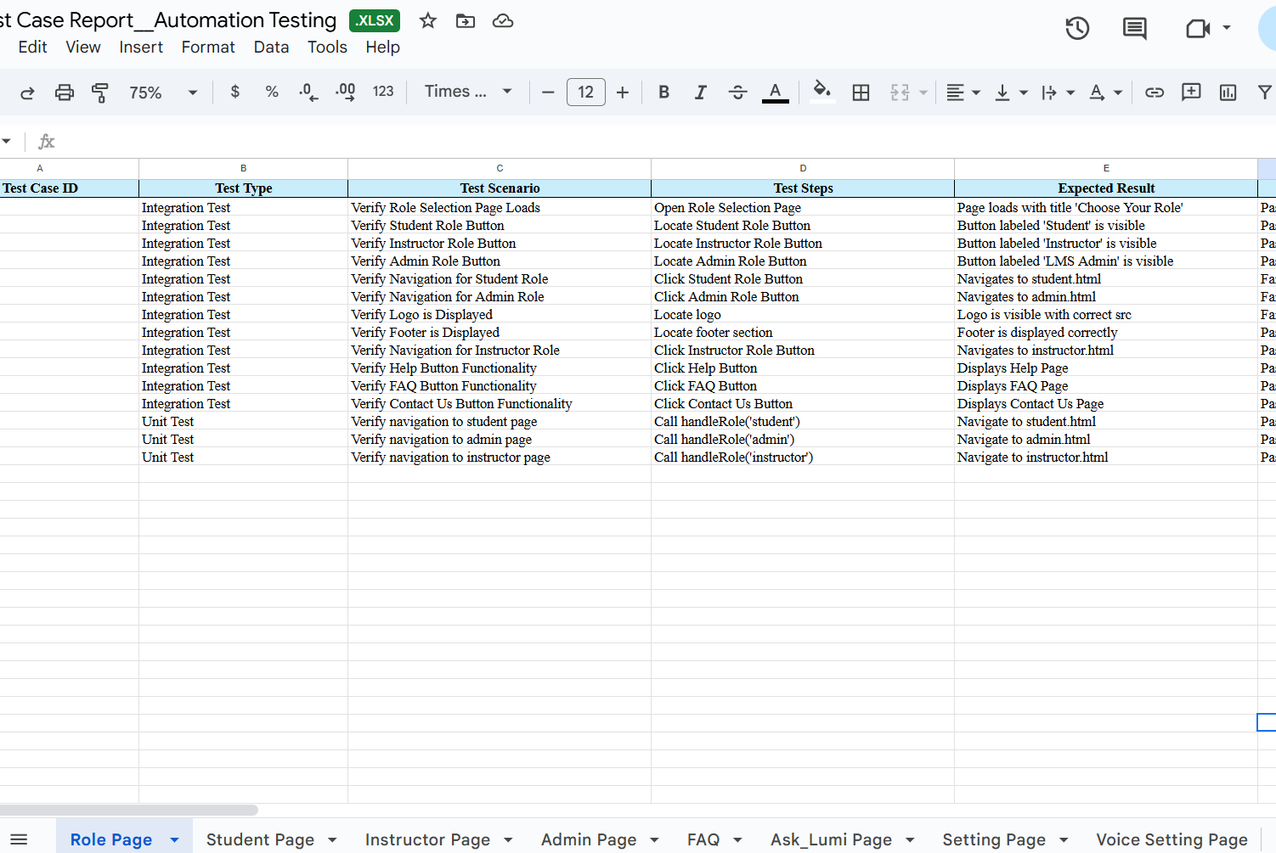
Test Case Report
Test Report: https://drive.google.com/drive/folders/1OFDHtE6gZ0YCyiwoQm4nAx5vIUQhM6wH?usp=sharing

Slide 23
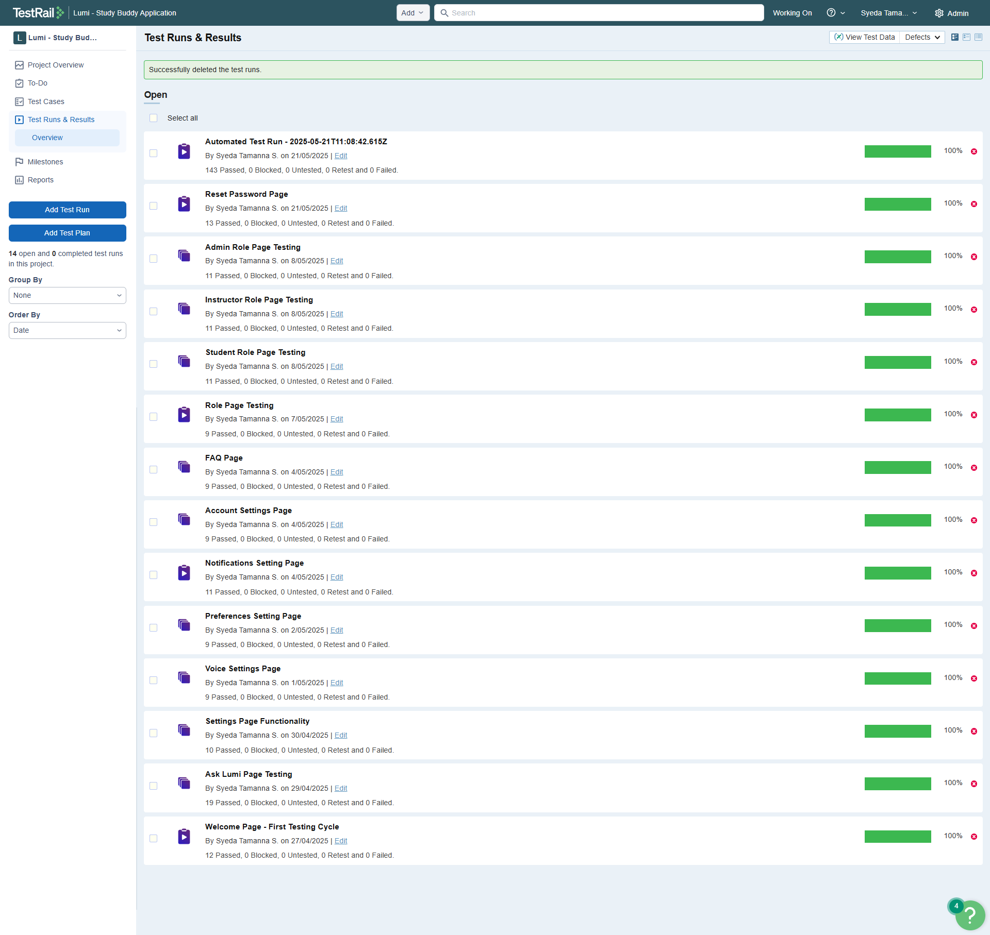
All Test Runs

Slide 24
Jira Integration
Enable in
Enable in Admin > Integration
Link
Link Test Cases to Jira issues via Reference field (e.g., Scrum-191)
Create
Create Jira issues directly from failed test cases
Track
Track issue status from within TestRail

Slide 25
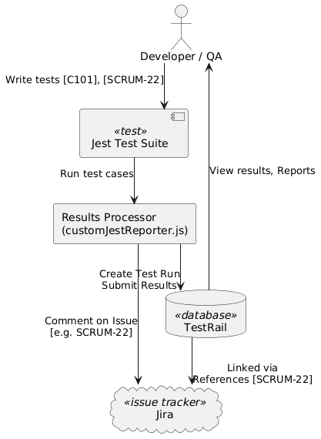
Jira Integration

Slide 26
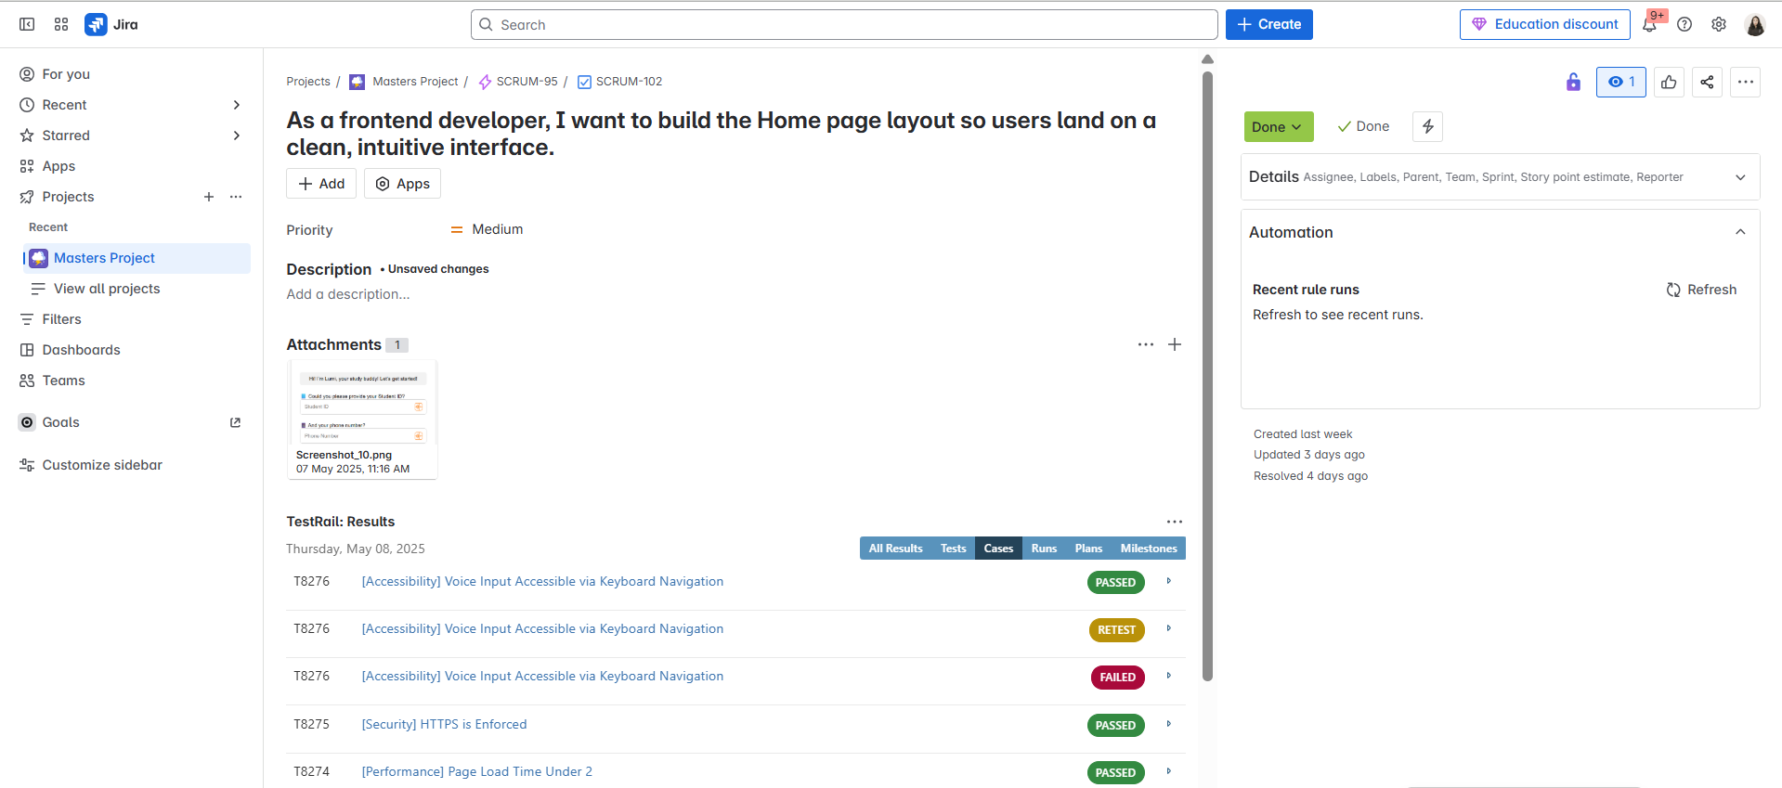
Jira Connected With Test Rail

Slide 27
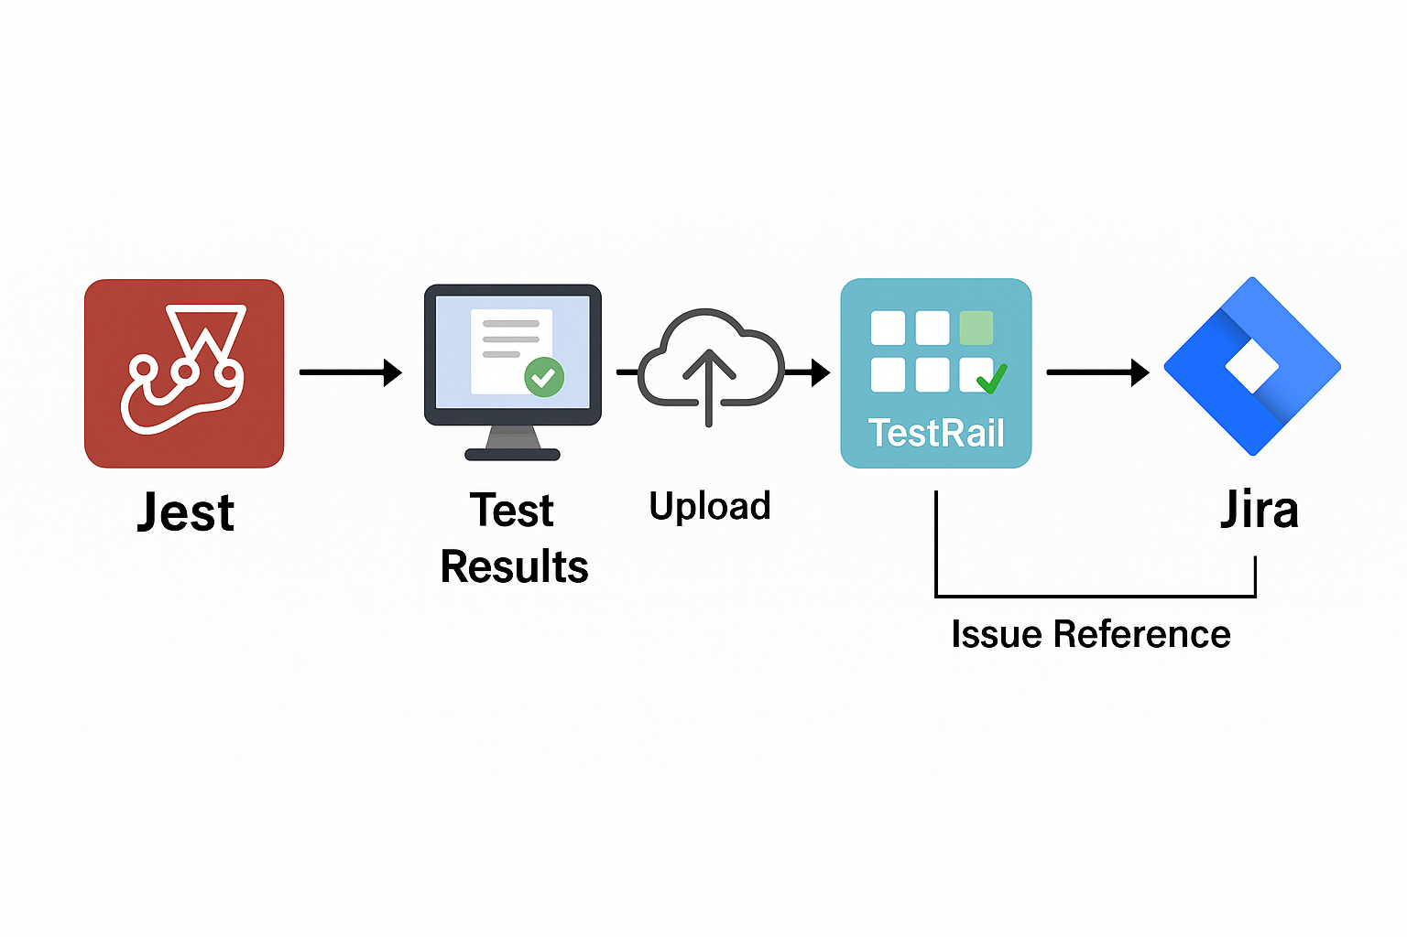
Custom Automation Integration with Jest, TestRail, and Jira
customJestReporter.js handles result upload after Jest test execution.
Test results are extracted and formatted with associated TestRail Case IDs.
Results are posted to TestRail via REST API (add_run, add_results_for_cases).
If a Jira key is tagged (e.g., [SCRUM-101]), test outcome comments are auto-posted to Jira.
Uses environment-secured credentials from .env (testrail.config.js supports .env protection).

Slide 28
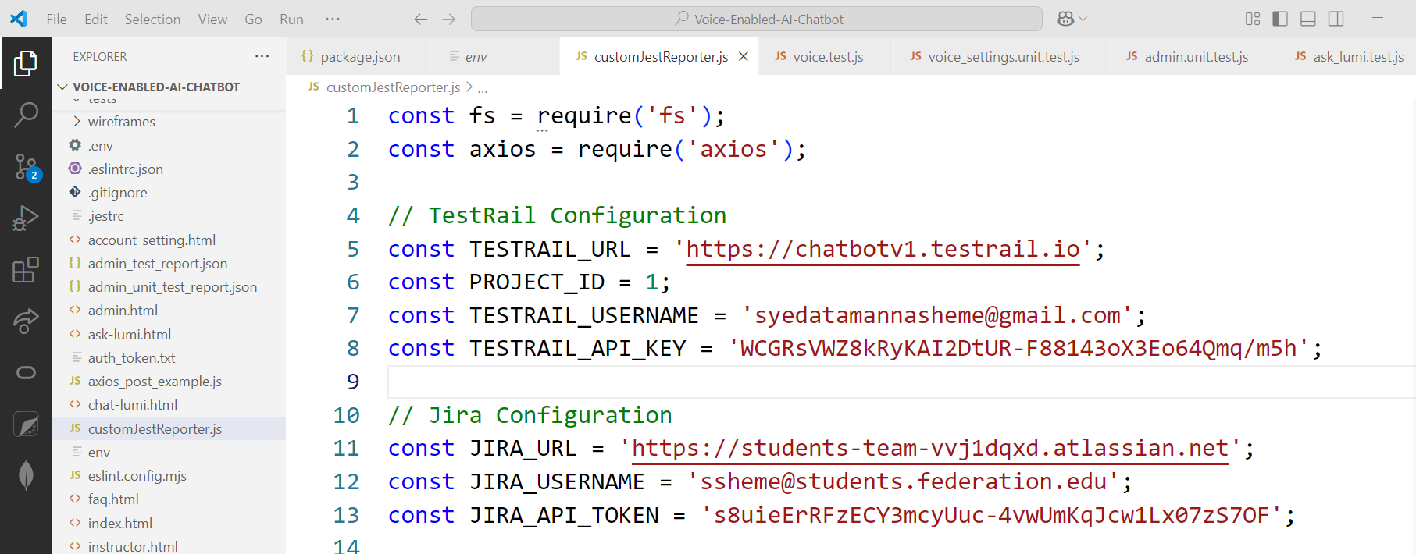
customJestReporter.js

Slide 29
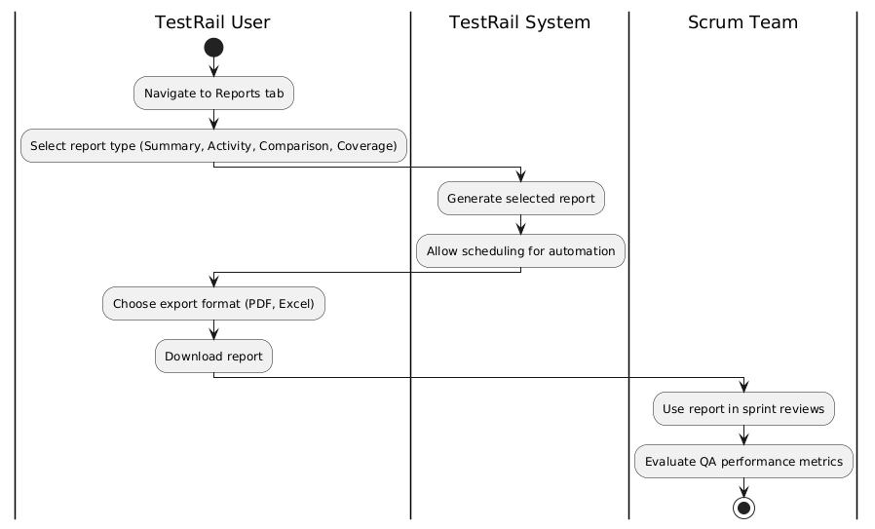
Reporting In TestRail

Slide 30
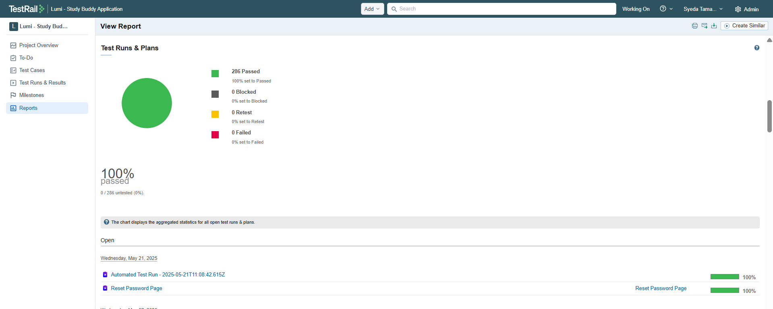
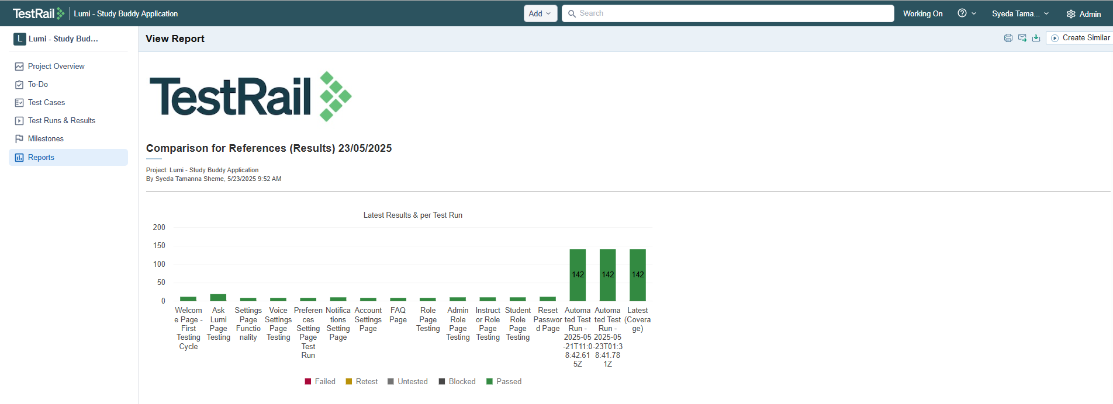
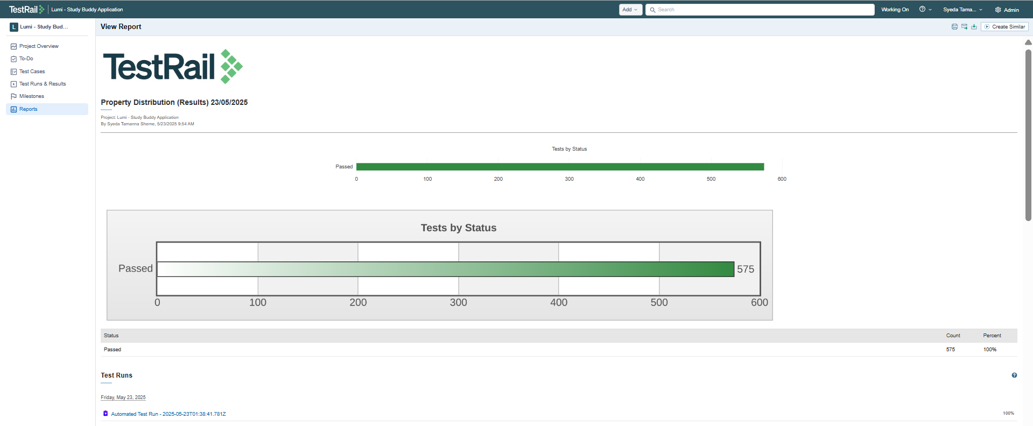
Test Rail Report
Test Rail Report: https://drive.google.com/drive/folders/12VatPyN-9Oqc2DipI8viFHERUdzO1-G9?usp=sharing

Slide 31
Conclusion
Central hub for test management
Works with manual & automated tests
Smooth Jira integration for traceability
Enhances transparency in Agile workflows

Slide 32
Thank You

